Slide 1
Cholesterol and Bone Demineralization:
From Observational Associations to Causal Mechanisms
Dave Bridges Lab | University of Michigan
Surface Lab Update — November 13, 2026
Seven converging lines of evidence: DO mice · meta-analysis · bidirectional MR · HMGCR drug-target MR · BMD mechanism MR · robust overlap-corrected MR · EHR statin analysis

Slide 2
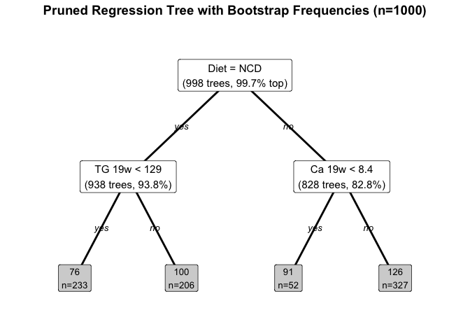
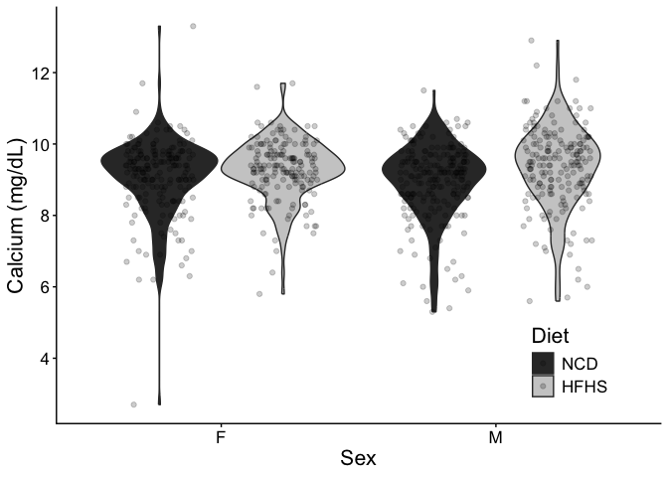
The Discovery: Calcium–Cholesterol in Diversity Outbred Mice
Cousineau et al., Nutrients 2024 | Svenson cohort, n = 850 | NCD + HFHS diets
Serendipitous Discovery
Hypothesis-naïve bootstrapped regression tree
Serum calcium: top predictor of cholesterol
  (after diet and triglycerides)
1 mg/dL ↑ Ca → 12.7 ± 0.8 mg/dL ↑ Chol
  p = 3.0 × 10⁻⁴³; ω²ₚ = 22%
Spearman ρ ≈ 0.40–0.50 across conditions
Replicated in both sexes and both diets
→ Top panel: tree (Ca = first split)
→ Bottom panel: Ca–Chol scatter by strata
Bridges Lab · University of Michigan

Slide 3
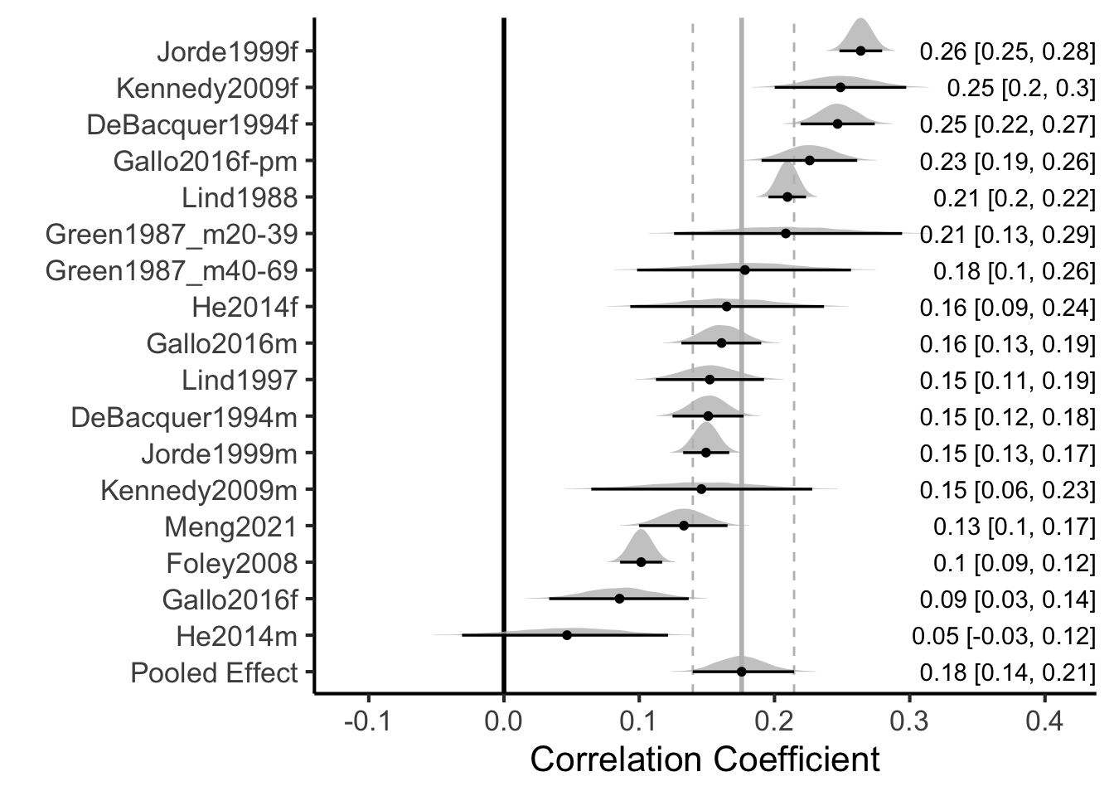
Meta-Analysis of Calcium–Cholesterol Associations in Humans
10 studies · 88,939 participants · 17 subgroups
Summary Statistics
Frequentist meta-analysis:
  r = 0.17 ± 0.018, p = 4.2 × 10⁻⁸
Bayesian hierarchical model:
  Prior from DO mouse data (ρ ≈ 0.45)
  Posterior r = 0.176 (95% CI: 0.140–0.214)
  P(r > 0) = 1.000 (Bayes Factor > 100)
  P(r < 0.39) = 1.000 — attenuated vs mice
Between-study variance: τ = 0.071
Global reach: Europe, Asia, Middle East
Both sexes; ages 20–75+
Bridges Lab · University of Michigan

Slide 4
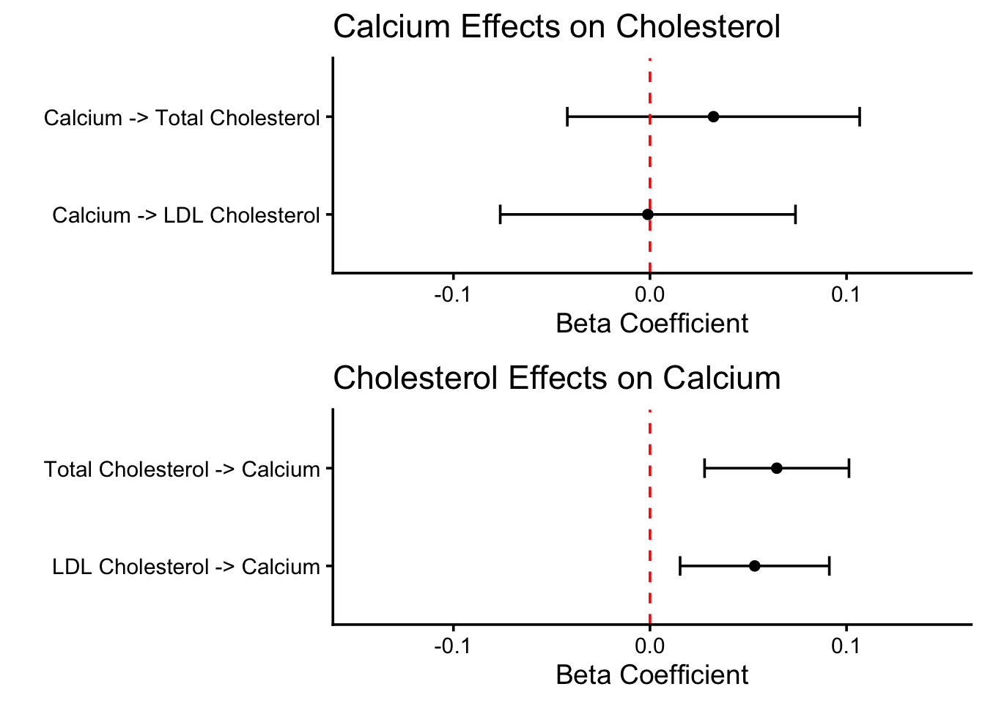
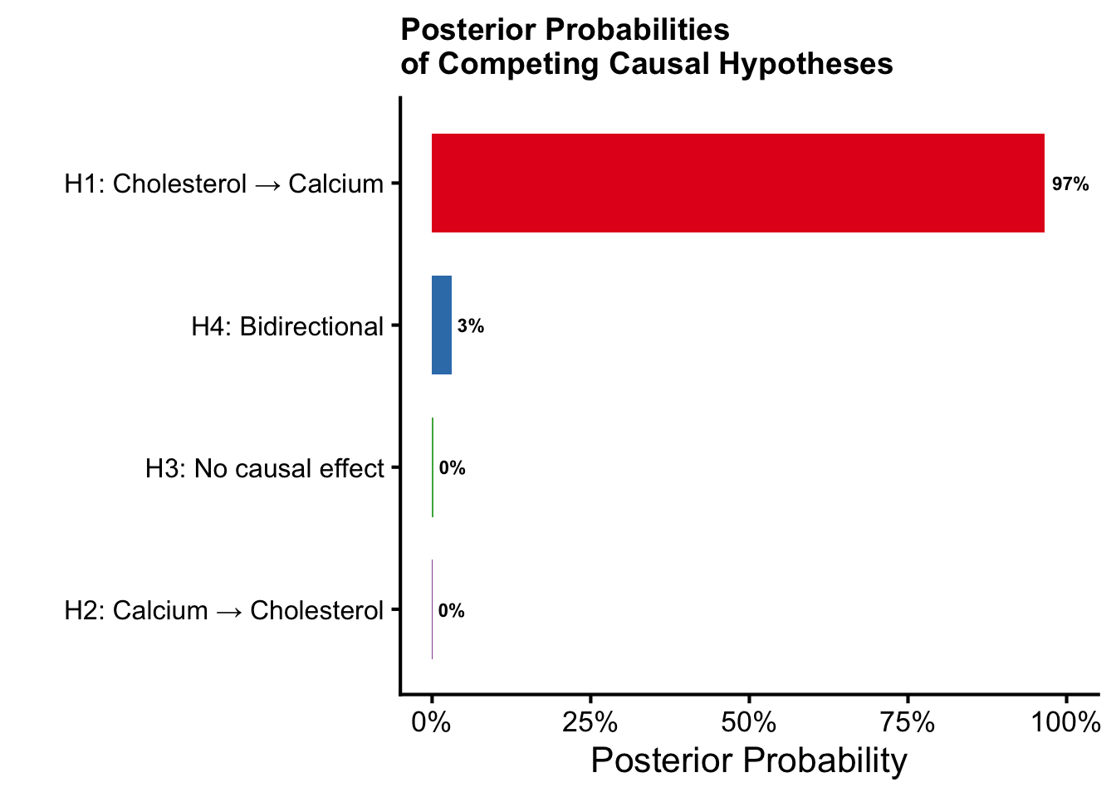
Bidirectional MR: Chol → Ca, Not the Reverse
Two-sample MR, UK Biobank instruments → Michigan Genomics Initiative (n = 102,441)
Results
FORWARD (Cholesterol → Calcium)
Total Chol → Ca: β = 0.065, p = 5.8×10⁻⁴ ✓
LDL-C → Ca: β = 0.053, p = 0.006 ✓
Robust: MR-Egger, WM, PRESSO, MR-RAPS
REVERSE (Calcium → Cholesterol)
Ca → Total Chol: β = 0.032, p = 0.39 ✗ NULL
Ca → LDL-C: β = −0.001, p = 0.98 ✗ NULL
Instruments:
LDL-C: 236 SNPs, R² = 0.089, F = 173
Total Chol: 285 SNPs, R² = 0.097, F = 159
Calcium: 277 SNPs, R² = 0.064, F = 95
Bayesian model comparison:
96.5% posterior for Chol → Ca (unidirectional)
Bridges Lab · University of Michigan

Slide 5
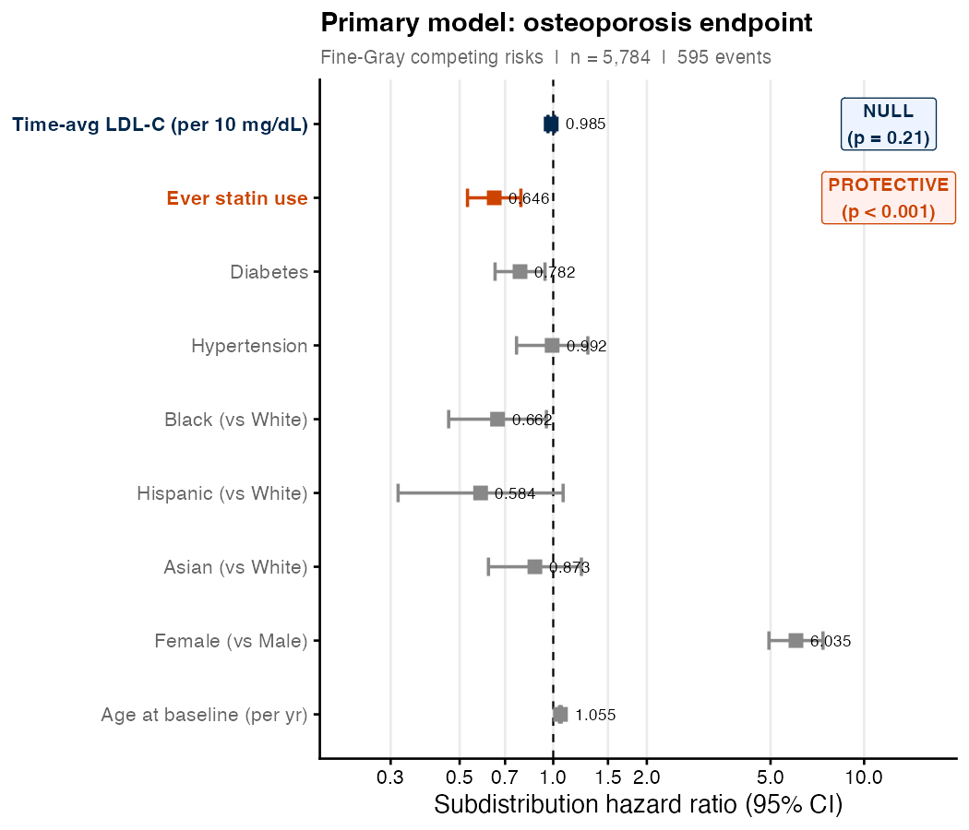
Clinical Evidence: Statins Protect Bone Independent of LDL-C
Michigan Genomics Initiative EHR; Fine-Gray competing risks (n ≈ 5,784; 595 osteoporosis events)
Primary Results (Osteoporosis Endpoint)
LDL-C (per 10 mg/dL)
Sub-HR = 0.985 (0.962–1.009) | p = 0.21 — NULL
Ever statin use
Sub-HR = 0.650 (0.530–0.787) | p < 0.001 — PROTECTIVE
Female sex
Sub-HR = 6.035 (4.941–7.372) | p < 0.001
Age (per year)
Sub-HR = 1.055 (1.048–1.061) | p < 0.001
Robust across 9 model specifications:
Fine-Gray 3-state (MACE + death competing), baseline, LOCF
Standard Cox, time-varying, statin-naive subgroup, all patients
→ LDL-C null in all 9; statin protective in primary model
Statin bone-protection (Sub-HR 0.65) persists after full LDL-C adjustment —
mevalonate pathway, not cholesterol lowering
Bridges Lab · University of Michigan

Slide 6
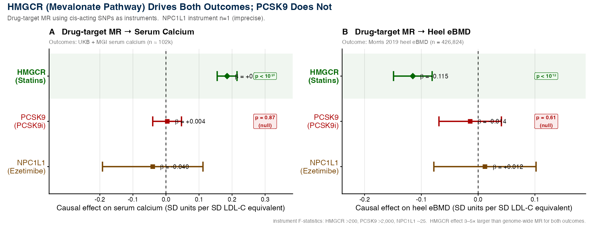
HMGCR/Mevalonate Drives Both BMD Loss and Calcium Rise
cis-SNPs for HMGCR, PCSK9, NPC1L1 as instruments; heel eBMD (Morris 2019, n=426k) + serum Ca (MGI, UKB)
HMGCR → BMD: β=−0.115, p<10⁻¹² ✓
PCSK9 → BMD: β=−0.014, p=0.61 ✗
HMGCR → Ca: β=+0.185, p<10⁻²⁰ ✓
PCSK9 → Ca: β=+0.004, p=0.87 ✗
Same mevalonate fingerprint for both outcomes: HMGCR (statin target) drives BMD ↓ and Ca ↑; PCSK9i (mevalonate-independent) is null for both. Effect sizes 3–5× larger than genome-wide MR.
Bridges Lab · University of Michigan

Slide 7
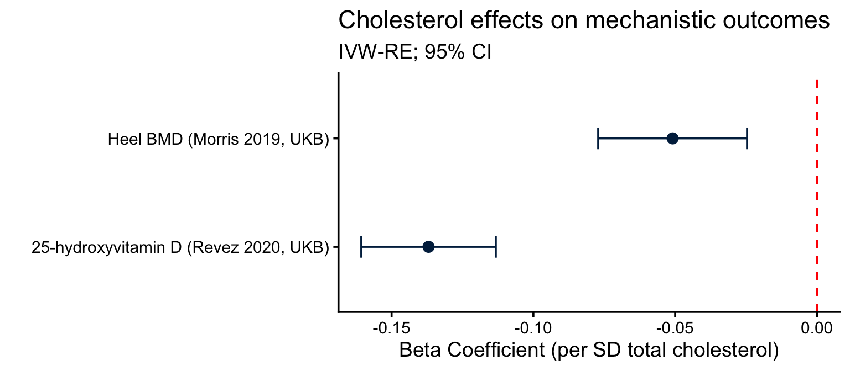
Cholesterol Lowers BMD — But Not Through Vitamin D
Drug-target & downstream MR; heel BMD (Morris 2019, n=426,824) and 25-OH Vit D (MGI-BioVU)
Hypothesis 1: Chol → ↑ Vitamin D → bone effect ✗ REFUTED
Cholesterol is a Vit D precursor → hypothesis: higher
  Chol → higher 25-OH Vit D → better bone
MR: Total Chol → 25-OH Vit D (Revez, UKB n ≈ 418k):
  β = −0.137, p = 10⁻²⁹ ← INVERSE sign
  Higher cholesterol → lower vitamin D
Bayesian model weight: 2.7% for VitD route
Hypothesis 2: Chol → ↓ BMD ✓ WELL SUPPORTED
Genome-wide Chol → Heel eBMD (Morris 2019, n = 426,824):
  β = −0.051, p = 1.4×10⁻⁴ (280 SNPs)
  WM: −0.026; WMode: −0.031; PRESSO: −0.047
HMGCR drug-target → Heel eBMD:
  β = −0.115, p < 10⁻¹² (37 cis-SNPs)
  ~2× larger than genome-wide estimate
PCSK9 → Heel eBMD: β = −0.014, p = 0.61 ✗ null
  Mevalonate-specific fingerprint (same as Ca)
Fractures (Dönertaş, n ≈ 484k): β ≈ 0.0002, p = 0.73
  BMD effect without fracture effect = density, not quality
Bayesian model weight: 97.3% for BMD route
Bridges Lab · University of Michigan

Slide 8
Bone Loss and Calcium Rise Are Parallel — Not Serial — Effects
MVMR mediation + mediator screen: BMD → Ca is null at every skeletal site
Original Hypothesis (REFUTED):
↑ Cholesterol → ↓ BMD → ↑ Serum Ca (bone as the source of elevated calcium)
✗ Mediation link 2 (BMD → Ca) is NULL at every skeletal site
Current Model (SUPPORTED):
↑ HMGCR activity → ↓ BMD (parallel)
↑ HMGCR activity → ↑ Serum Ca (parallel; calcium-specific mechanism — probably renal/tubular)
Mediation Evidence:
Heel eBMD → Ca
β = −0.009, p = 0.45
301 SNPs, F = 197
Femoral neck BMD → Ca
β = −0.001, p = 0.97
—
Total body BMD → Ca
β = −0.012, p = 0.42
—
HMGCR via BMD (mediation)
~0.5% of total effect
Negligible
HMGCR → Phosphate (PO₄)
β = 0.027, p = 0.15 (FLAT)
Rules out PTH, VitD, bone resorption
HMGCR → Ca | albumin
112% of total effect
Not an albumin artefact
Bridges Lab · University of Michigan

Slide 9
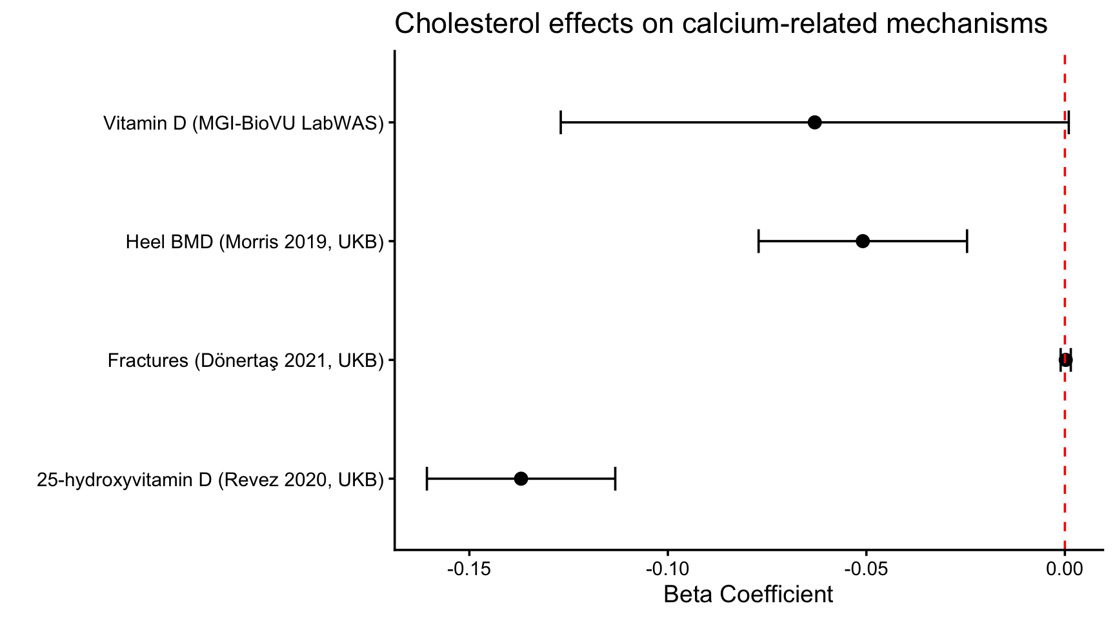
Robust MR: Cholesterol → BMD Survives Overlap & Pleiotropy Corrections
5 estimators × 2 exposure arms (overlapping GLGC 2021 + overlap-free GLGC 2013)
Method
@ 5×10⁻⁸
@ 5×10⁻⁵
Key feature
IVW (random effects)
−0.067
—
Baseline; SE ~4× too narrow
MR-RAPS (ℓ₂)
−0.084
−0.056
Weak-IV corrected; balanced pleiotropy
MR-RAPS (tukey robust)
−0.062
−0.043
Robust loss; outlier-deletion pushes toward null
MRBEE
−0.072
−0.051
Overlap (Rxy) + estimation-error bias correction
MR-APSS
—
−0.056
LDSC C-matrix + winner's-curse; overlap-free: −0.037
CAUSE (γ)
—
−0.040
Shared-factor model; model comparison inconclusive
Sample overlap (MR-APSS)
0.004 (0.17 SE)
—
IMMATERIAL — measured, not assumed
Pleiotropy SD (τ̂)
0.005 (~3× SE)
—
Heavy but diffuse → random-effects treatment
All 5 methods negative; honest interval ≈ −0.09 to −0.01. CAUSE directionally consistent; model comparison inconclusive (low power). Threshold drives more variation between methods than model assumptions do.
Bridges Lab · University of Michigan

Slide 10
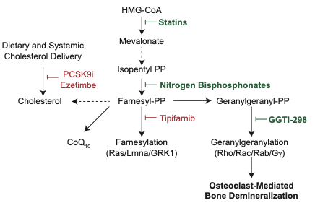
Proposed Mechanism: GGPP Depletion in Osteoclasts
Mevalonate → GGPP → Rho GTPase prenylation → osteoclast-mediated bone demineralization
MR/EHR evidence summary
HMGCR → Ca: β = 0.185 (p < 10⁻²⁰)
HMGCR → BMD: β = −0.115 (p < 10⁻¹²)
PCSK9 → Ca: β = 0.004, p = 0.87 ✗ NULL
PCSK9 → BMD: β = −0.014, p = 0.61 ✗ NULL
HMGCR eQTL (blood) → BMD: β=−0.044, p=4.4×10⁻⁵
Statin (EHR): Sub-HR = 0.65, LDL-C independent
Key implication:
Statins: block HMGCR → deplete GGPP → impair
Rho GTPase prenylation in osteoclasts.
Ezetimibe / PCSK9i: bypass mevalonate → no bone benefit.
N-bisphosphonates: block FPP synthase (same pathway).
→ Aim 2 will test GGPP with Ggps1 KO + GGTI-298.
Bridges Lab · University of Michigan

Slide 11
Proposed R01 Aims
Hypothesis: mevalonate flux promotes bone demineralization via GGPP depletion in osteoclasts
Aim 1: Define Whether Statin-Mediated Bone Protection Is Mevalonate-Dependent
1A
WT mice (both sexes, NCD + HFHS): pravastatin vs. evolocumab (PCSK9i) vs. ezetimibe at equivalent LDL-C reductions. Outcomes: bone density, architecture (μCT), strength, turnover.
1B
Osteoclast-specific Hmgcr knockout mice: defines cell-type specificity of the statin bone effect.
1C
MVMR (human): formally test HMGCR → BMD → Ca causal chain vs. parallel effects in UKB/MGI.
1D
EHR (All of Us): statin vs. ezetimibe initiators → incident fracture and BMD (active-comparator design).
Aim 2: Establish That Geranylgeranylation Mediates Statin-Mediated Bone Protection
2A
Primary osteoclasts from Aim 1 mice: GGPP supplementation rescue test — does GGPP restore statin/bisphosphonate-inhibited osteoclast differentiation? RhoA/Rac1 prenylation readout.
2B
Osteoclast-specific Ggps1 KO (GGPP synthase): in vivo ablation of GGPP in the osteoclast lineage.
2C
Pharmacological validation: GGPP synthase inhibitor (GGTI-298) in HFHS diet mice. Primary outcomes: bone density, strength, architecture (μCT).
Expected outcome: statins (not PCSK9i, not ezetimibe) are bone-protective via mevalonate/GGPP; osteoclast-specific Ggps1 KO phenocopies statin treatment on bone.
Bridges Lab · University of Michigan

Slide 12
Open Questions and Where We'd Value Your Expertise
Areas where in vivo / cell bone biology expertise is critical
What We Have
Where We'd Value Your Input
Strong human MR + epidemiological evidence base
HMGCR/mevalonate pathway specificity (vs PCSK9, NPC1L1)
EHR clinical cohort (MGI, ~20,000 patients)
Bioinformatics / statistical genetics expertise
Planned analyses (near-term):
  Update meta-analysis (new studies identified)
  MRBEE/CAUSE bidirectional MR in DO mice
  (test Chol↔Ca direction in the mouse data)
  Renal test: HMGCR → urinary Ca excretion
  PTH via deCODE pQTL (Ferkingstad 2021, n≈35k)
  All of Us: statin vs ezetimibe fracture analysis
Osteoclast model systems:
  Best primary osteoclast protocols for statin/GGPP studies?
  Cell lines vs. primary for differentiation assays?
  RhoA/Rac1 prenylation readout approaches?
In vivo bone phenotyping:
  Bone strength testing (3-pt bending vs. compression)?
  Turnover markers: plasma CTX / P1NP / osteocalcin?
  μCT parameters most sensitive to osteoclast activity?
Conditional KO models:
  Preferred Cre driver: Ctsk-Cre vs. LysM-Cre?
  Known osteoblast 'leak' issues to be aware of?
Visualizations still needed (flagged):
  Statin vs. ezetimibe in vivo bone phenotype schematic
  Clinical trial fracture aggregate figure
Bridges Lab · University of Michigan

Slide 13
Summary
Seven converging lines of evidence for a causal cholesterol → bone demineralization pathway
1.
DO mice + human meta-analysis: consistent Ca–Chol correlation (r = 0.176, p = 4.2×10⁻⁸; Spearman ρ ≈ 0.4–0.5 in mice)
2.
Bidirectional MR: Chol → Ca (p < 0.001); Ca → Chol = NULL. 96.5% Bayesian posterior for unidirectional direction
3.
Pathway specificity: HMGCR β ≈ 0.185 (3–5× genome-wide); PCSK9 β = 0.004 (F > 2000, null) → mevalonate, not LDL-C
4.
Bone as intermediate: HMGCR → BMD β = −0.115 (p < 10⁻¹²); PCSK9 → BMD = null. Identical mevalonate fingerprint
5.
Serum Ca is homeostatically defended: BMD → Ca null at all 3 skeletal sites. Bone loss and Ca rise are parallel effects
6.
Robust to pleiotropy/overlap: 5 methods × 2 exposure arms all negative. Honest CI: β ≈ −0.09 to −0.01
7.
Clinical: statins protect bone (Sub-HR 0.65) independent of LDL-C in MGI EHR — mevalonate mechanism confirmed
Hypothesis: mevalonate flux → GGPP depletion in osteoclasts → bone demineralization + Ca rise. Statins (not PCSK9i, not ezetimibe) block this. Bisphosphonates act downstream at FPP synthase.
Dave Bridges Lab · davebrid@umich.edu · University of Michigan

